Slide 1
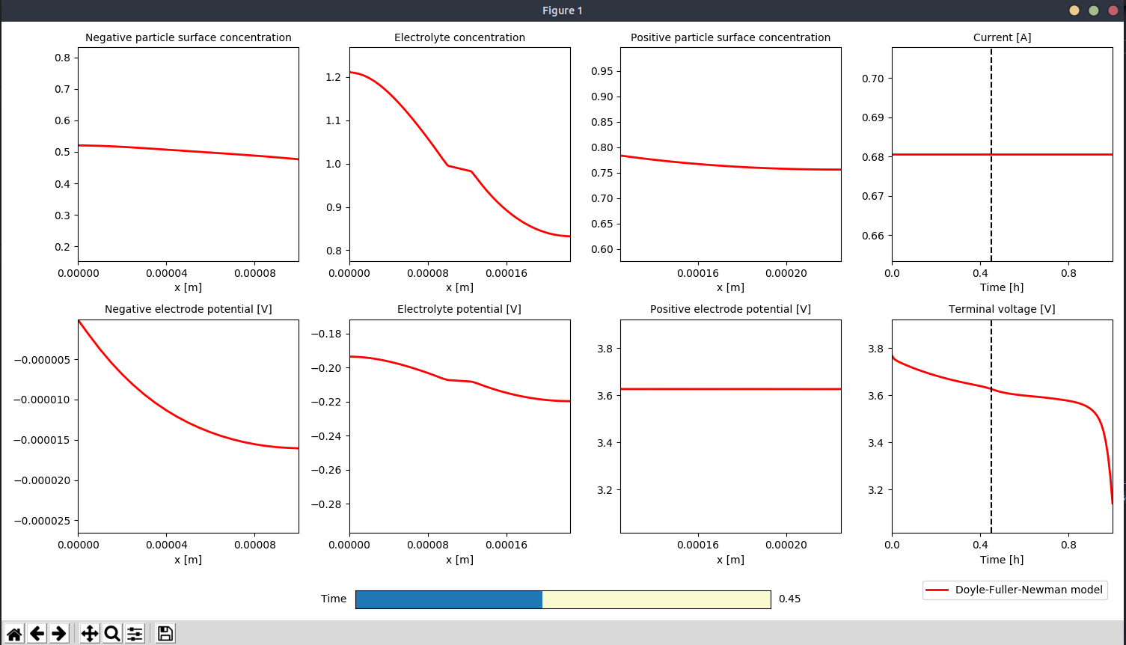
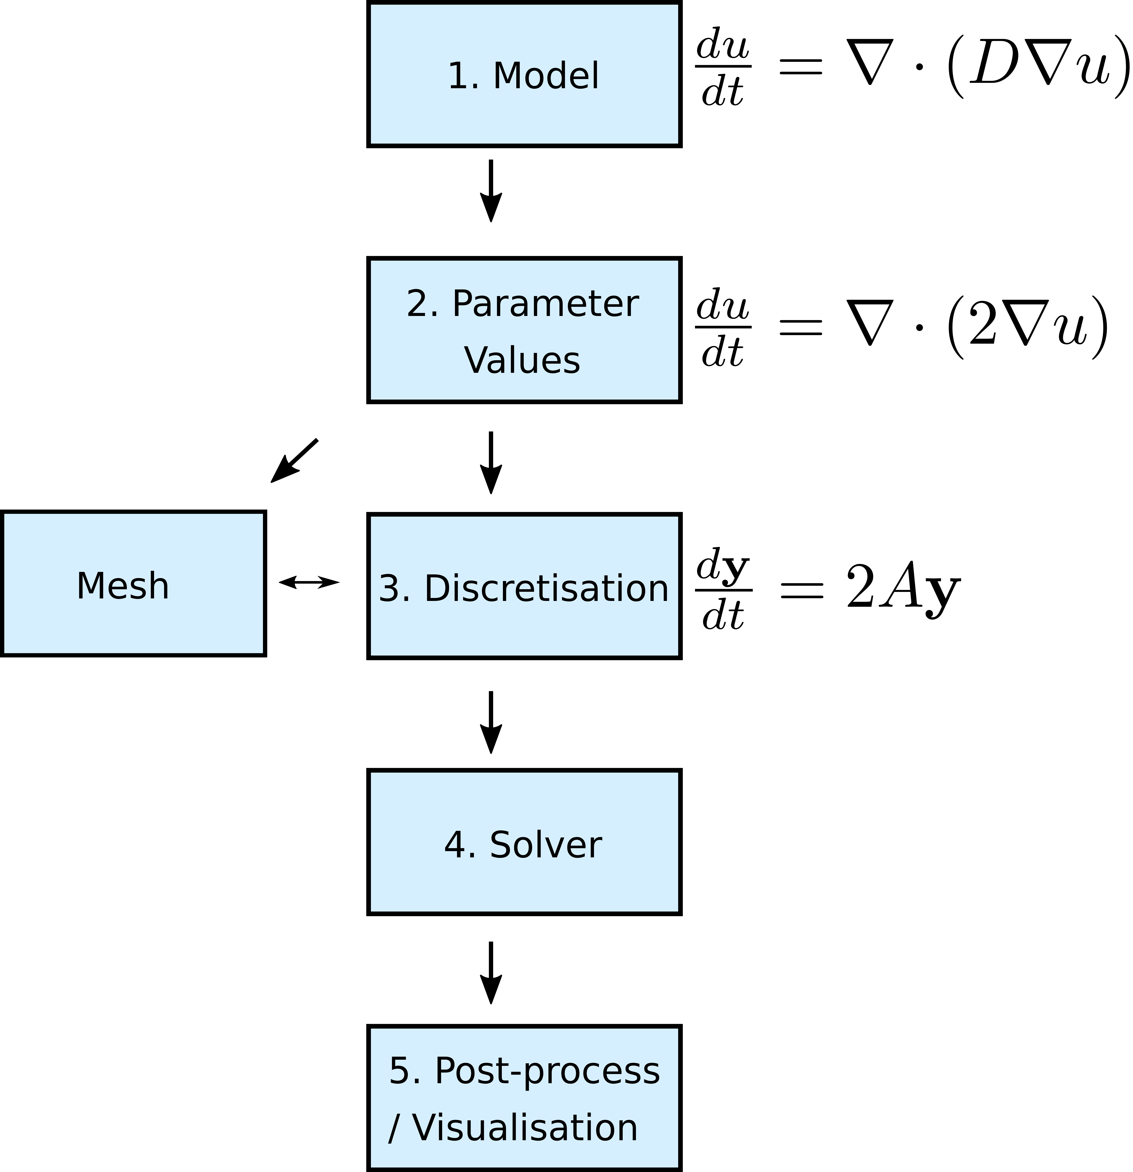
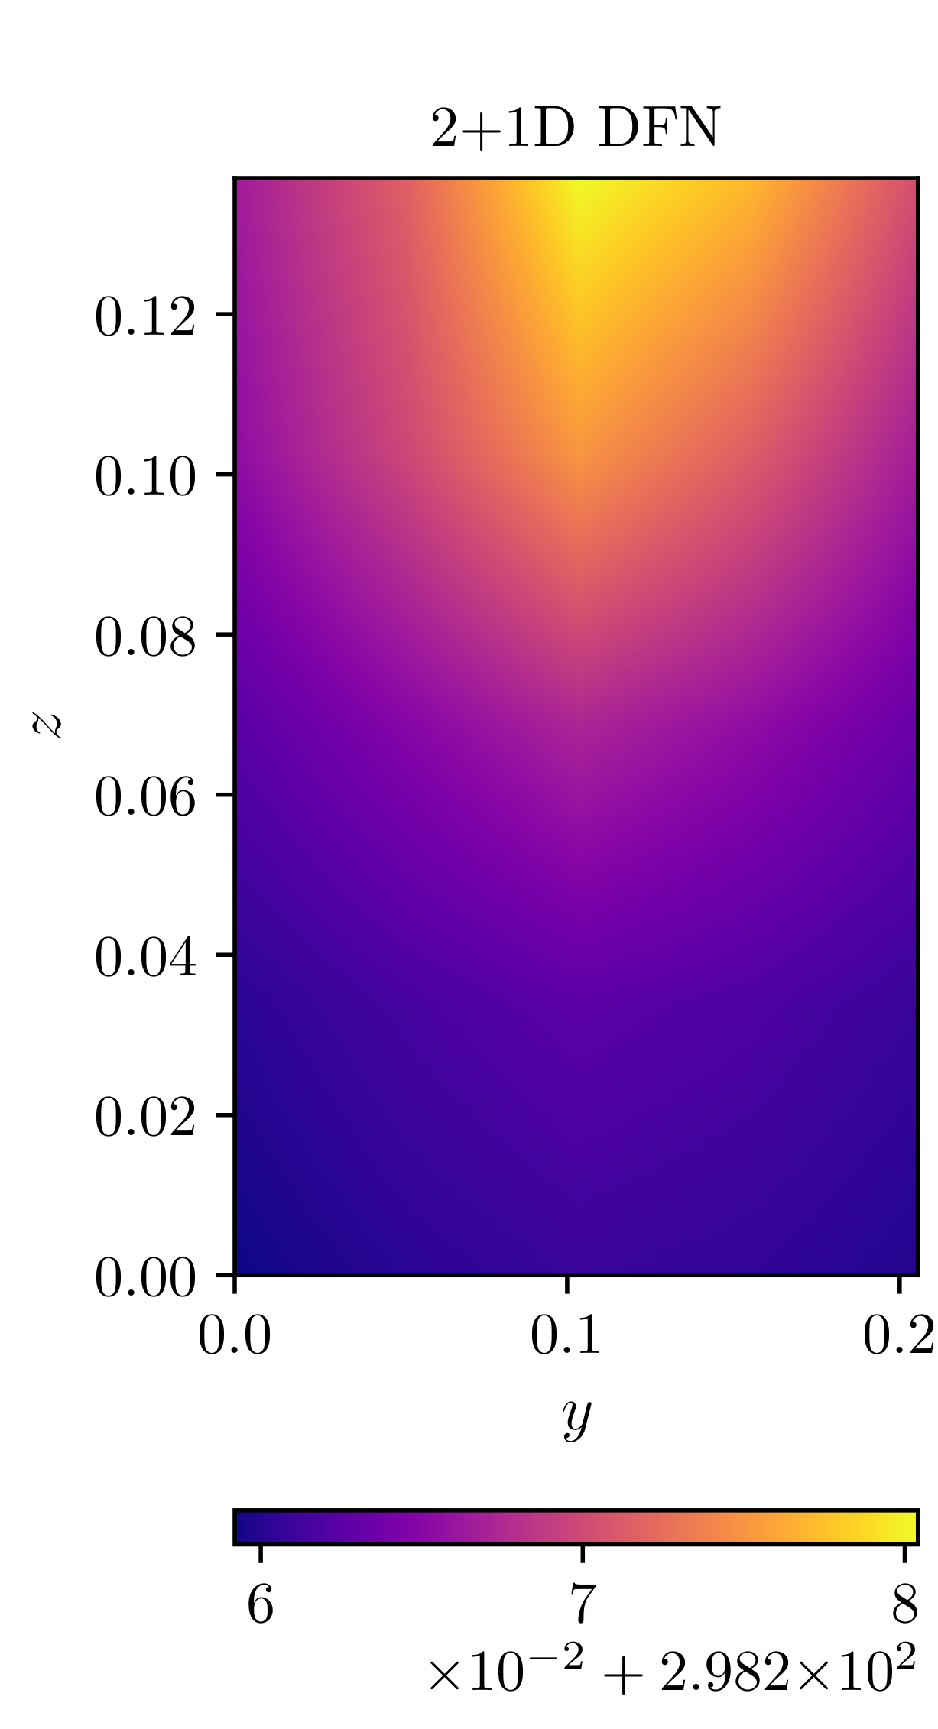
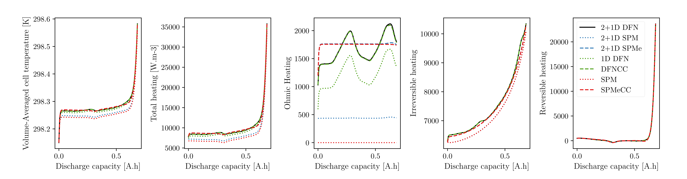
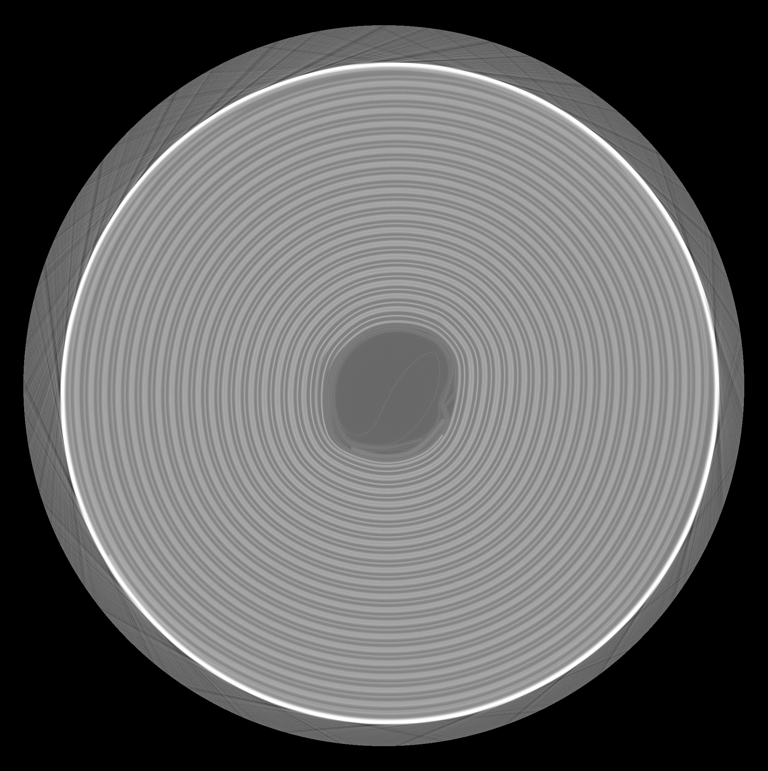
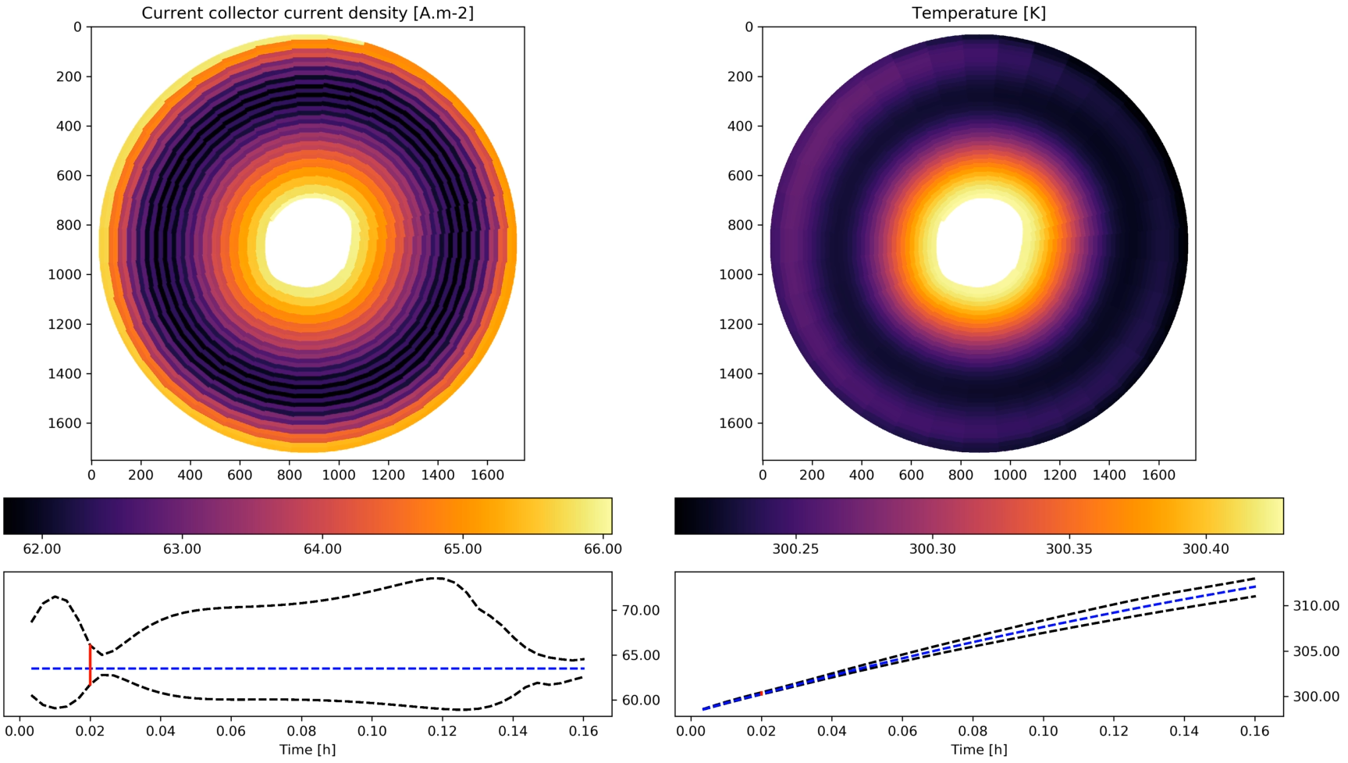
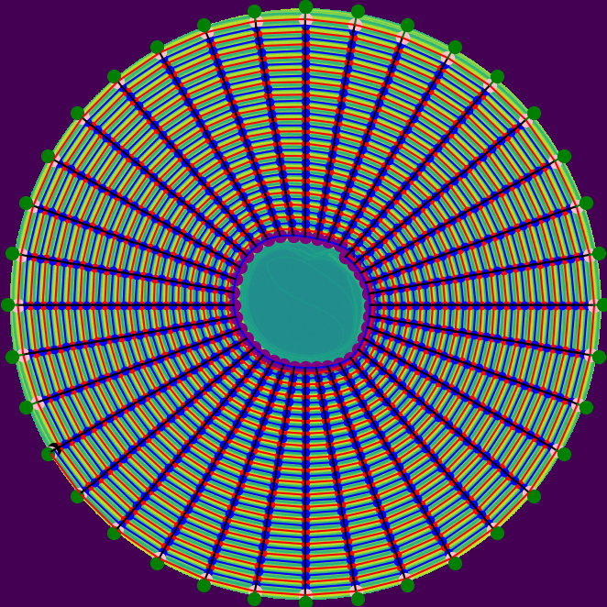
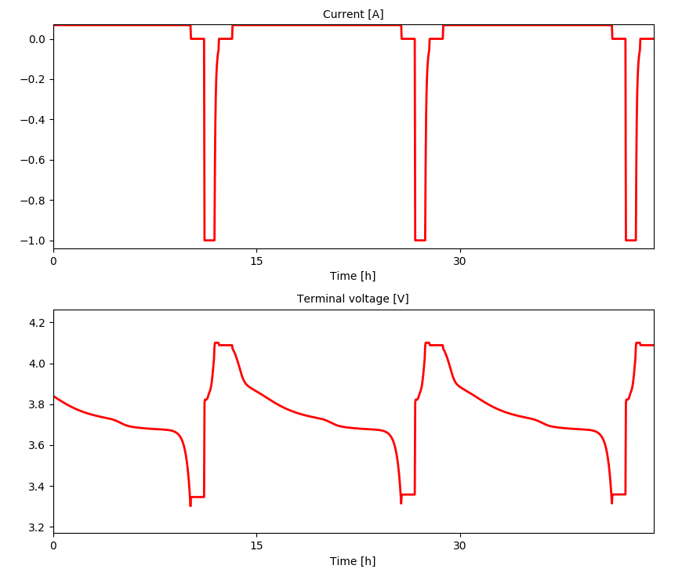
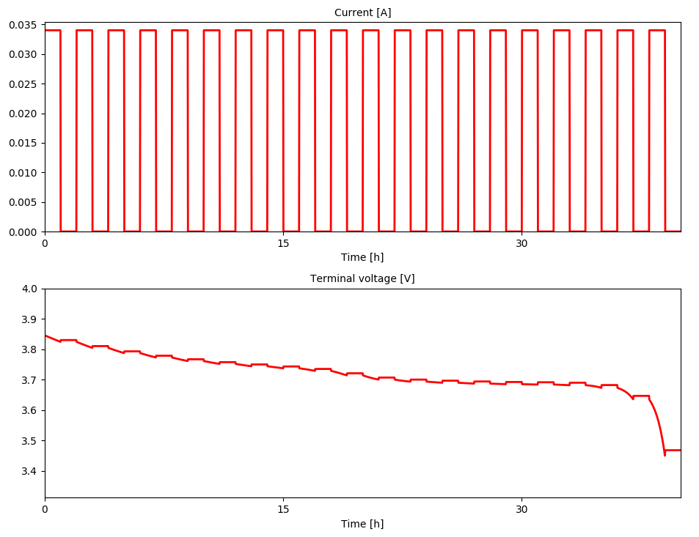





PyBaMM - Python Battery Mathematical Modelling
A flexible, open-source python package for development, comparison, and fast solutions of physics-based battery models.
Valentin Sulzer, Scott G Marquis, Robert Timms, Tom Tranter,
Ferran Brosa Planella, Jacqueline Edge, Martin Robinson, Thibault Lestang, S Jon Chapman
As the worldwide battery modelling community grows, there is a clear need for software that uses modern software engineering techniques to facilitate cross-institutional collaboration on battery research. The Python package PyBaMM addresses this need by being
Open-source and freely available
Flexible with a modular design
Well-tested by employing test-driven software development practices
PyBaMM allows users to easily:
Change model parameters
Run drive cycles/standard experimental routines (CCCV, GITT, etc)
Add additional physics (model equations entered symbolically)
Choose from several state-of-the-art numerical solution methods (with access to analytic Jacobians)
Achieve fast simulation times (Doyle-Fuller-Newman model with ~10⁵ states solved in under one second for a 1C constant current discharge)
Just like other python packages, PyBaMM can be easily installed on Windows, Mac, and Linux with just one command:
pip install pybamm
With just 5 lines of python code, we can run, solve, and plot the results for a 1C discharge of the classical Doyle-Fuller-Newman Model:
import pybamm
model = pybamm.lithium_ion.DFN()
sim = pybamm.Simulation(model)
sim.solve()
sim.plot()
abstract
Simple Installation
Flexible interactive plotting interface
The inbuilt modelling capabilities of PyBaMM includes:
Full-order (Doyle-Fuller-Newman) and reduced-order (e.g. Single Particle Model) lithium-ion battery models
Fully-coupled thermal extensions to these models
Versions of models in 1D, 2D, and 3D
Thermal results for an array of PyBaMM models of a single-layer pouch cell are shown below.
Pipeline
Thermal Modelling of Lithium-ion Pouch cells
By employing a pipeline process, PyBaMM separates the statement of model equations, from the inputted parameters, choice of spatial discretization, and choice of time solver. This modular approach allows:
Model equations to be easily changed to account for new physics
Adjoints to be calculated for parameter estimation routines
Spatial discretizations to be switched in/out without having to rewrite the model
Multiple time solvers to be interfaced to in a common manner
FAST SOLUTIONS
Millisecond solve times for a 1C discharge using the CasADi solver (n grid points per domain)
Tomography images are used to define equivalent circuit models with flexible placement of tabs and heat sources and sinks. PyBaMM is coupled with other software to compute equivalent resistances and generate heat sources for electrochemical and thermal analysis.
Single particle model (SPM)
Doyle-Fuller-Newman (DFN)
Modelling of JellyRoll Cells
Grid points | States | Time (ms)
10 | 21 | 3
20 | 41 | 3
40 | 81 | 4
80 | 161 | 5
160 | 321 | 9
Grid points | States | Time (ms)
10 | 281 | 50
20 | 961 | 90
40 | 3521 | 250
80 | 13441 | 930
160 | 52481 | 4010
18650
20 layers
2 Tabs
PyBaMM allows users to enter custom experimental procedures in text form using the Experiment object:
pybamm.Experiment(["Discharge at C/10 for 13 hours", "Rest for 1 hour", "Charge at 1 A until 4.1 V"])
Below, we display the results of running CCCV and GITT routines on the DFN model and using the built-in PyBaMM plot function.
Custom Experimental Procedures
1300 SPMs
V. Sulzer, S.G. Marquis, R. Timms, M. Robinson and S.J. Chapman. Python Battery Mathematical Modelling (PyBaMM). Submitted to Journal of Open Research Software.
S.G. Marquis, V. Sulzer, R. Timms, C.P. Please, and S.J. Chapman. An asymptotic derivation of a single particle model with electrolyte. Journal of The Electrochemical Society, 166(15):A3693–A3706, 2019.
V. Sulzer, S.J. Chapman, C.P. Please, D.A. Howey, and C.W. Monroe. Faster lead-acid battery simulations from porous-electrode theory: II. Asymptotic analysis. Journal of The Electrochemical Society, 166(12):A2372–A2382, 2019
references

